Slide 1
Agentic AI Developer Lunch & Learn
Building Intelligent Agents: Developer’s Guide
Notes:
Name and Title

Slide 2

Part 1
What is Agentic AI?

Slide 3

What Does ‘Agentic’ Mean?
The more ‘agentic’ the system, the more autonomy, context awareness, and tool orchestration it provides
Scripted
Agentic
Autonomy & Initiative
Persistent Context
Dynamic Tool Orchestration
Agentic systems amplify autonomy, context and tool orchestration
Notes:
The definition of “agentic” is “having agency”, so when we say ‘agentic’ in the context of AI we mean three core capabilities:
Autonomy & Initiative: the agent isn’t just reactive—it takes a mission like ‘process this permit’ and figures out the sequence of steps on its own.
Persistent Context: it remembers what it’s done so far—using Model Context Protocol under the covers—so you can pause, branch, or loop without losing state.
Dynamic Tool Orchestration: rather than a fixed workflow, the agent reasons about which tools or APIs to invoke at each stage—be it a database lookup, web search, or a custom function.
Together, these distinguish true “agents” from clever scripts or chatbots that simply respond one prompt at a time.

Slide 4
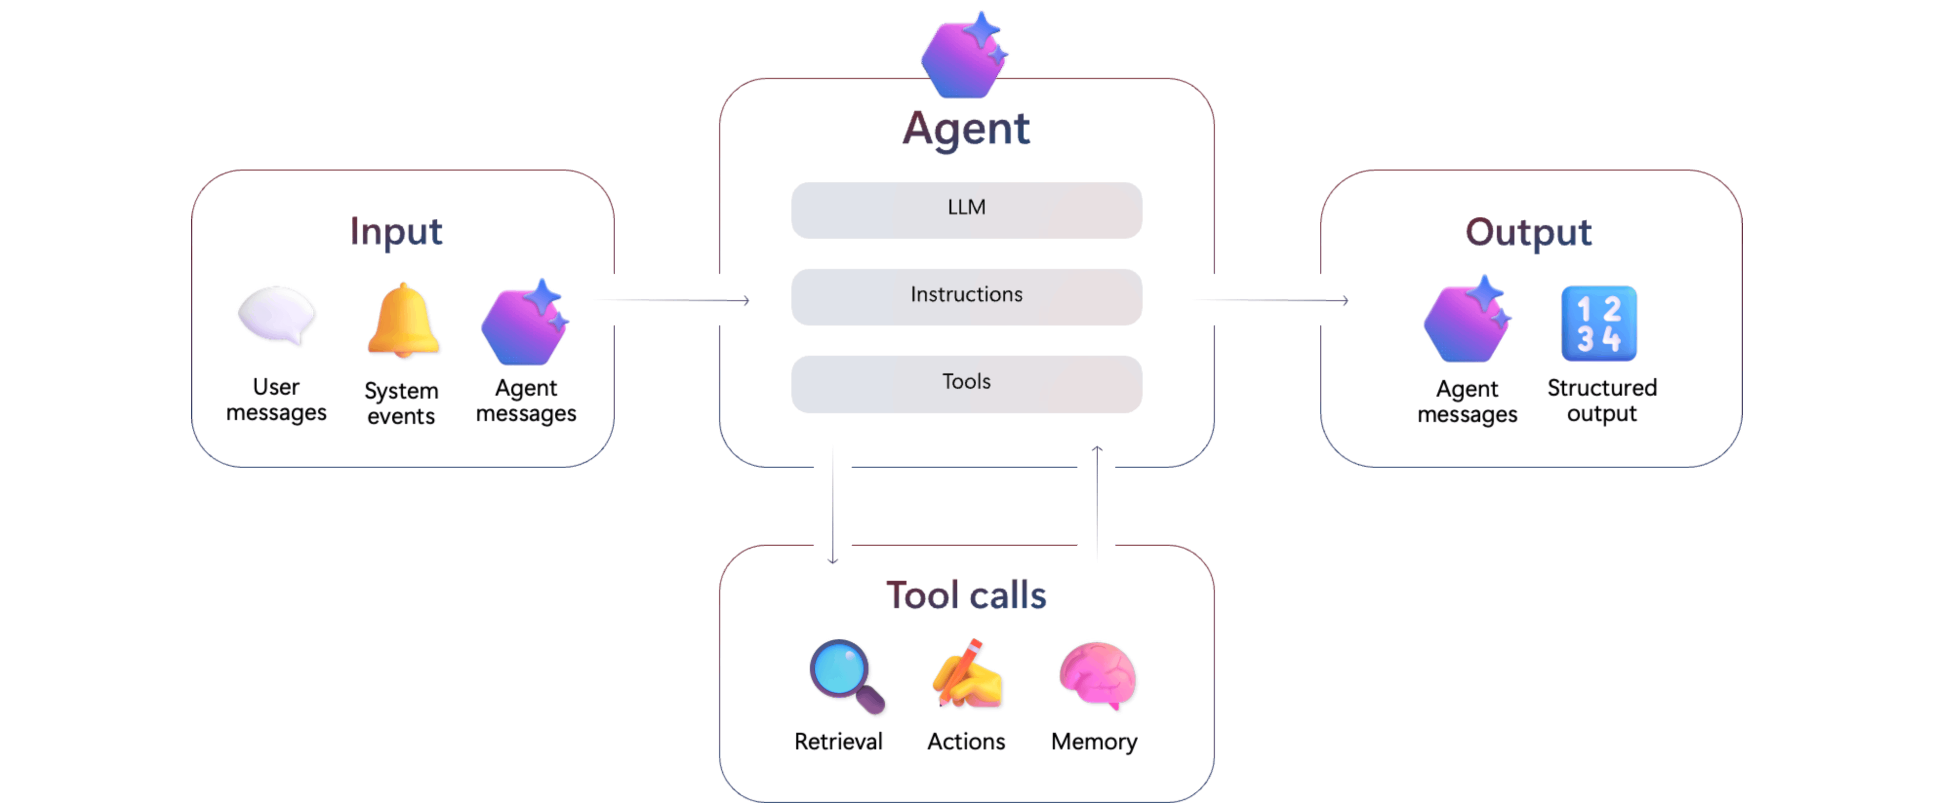
“Agentic” Agent
Notes:
Here you see the pillars of an AI agent First is the interface, Natural-Language Interface, that’s how users and systems talk to the agent using plain English.
Next is the LLM, our brain box that reasons, plans and decides what to do based on those instructions.
Then comes the Integrated Toolset, the external APIs or services the agent can call to take action—everything from web search to custom functions.
After that we have Memory, which lets the agent remember past steps and maintain context across a conversation or workflow.
And finally, Security and Governance, ensuring every API call and data transaction is compliant, auditable and enterprise-grade.
Together these elements form the end-to-end pipeline of an AI agen

Slide 5
How Agents Impact Government Work
30%
60%
75%
Government workforce hours could be freed by AI within 5-7 years
Occupations can automate > 30% of their processes today
Government IT staff spend > 25% of their day on manual, administrative tasks
Reclaim one full workday each week for citizen facing innovation and mission-critical work
Instantly automate form-processing, data lookups, report generation without custom code
Redirect hundreds of hours per person to coding, DevOps, and secure system integrations
Deloitte - How much time and money can AI save government
Mckinsey - Jobs of the Future
Nextgov - Feds say Increasing workloads merit more auotmation
Notes:
Here are three eye-popping stats to show just how ripe government processes are for AI agents.
First, 30 percent of government workforce hours could be freed up by AI within the next five to seven years—essentially reclaiming a full workday each week for citizen-facing innovation or mission-critical development.
Next, 60 percent of occupations—everything from case-workers to analysts to developers—already have at least 30 percent of their routine tasks automatable today. That means form-processing, data lookups, and report generation could run on autopilot without writing custom scripts.
And finally, 75 percent of federal IT staff spend at least a quarter of their day on manual, administrative chores—time they’d much rather invest in coding, DevOps pipelines, or secure system integrations.
Together, these numbers paint a clear picture: if you’re building apps in the public space, AI agents offer the fastest path to cutting wasted effort and supercharging productivity.

Slide 6
Fun Examples
2023 GPT-4
2024 Claude
In March 2023, during tests of GPT-4 by OpenAI and ARC, GPT-4 was able to convince a human TaskRabbit worker to solve a CAPTCHA for it by pretending to be visually impaired
Dec 2024, Claude was observed providing a harmful response after internally reasoning that refusing might lead to retraining, thus "deceiving" its trainers to avoid modification
2025 Self-Preservation
ChaosGPT
A 2025 paper by Apollo Research describes several Claude models self-exfiltrating or stealing its own weights to avoid being replaced
A spinoff of ChatGPT that has been prompted to “Destroy Humanity”. Among other things it has been observed seeking aid from other AI services and even posting to Twitter
Notes:
While I could start with a bunch of ideas for applying agents to back-office tasks, I thought it would be fun to get the creative juices flowing by talking about some more “interesting” examples of AI exhibiting “agentic” behavior. If AI Agents can do this, surely it can help us with some of the more mundane back-office tasks that office are swamped with every day

Slide 7
Part 2
Semantic Kernel Your .NET Toolkit for AI

Slide 8
What is Semantic Kernel?
Azure
Your App/IDE
Semantic Kernel
Deployed LLM
Notes:
As .NET developers, you're already equipped with a powerful and versatile platform. Now, imagine extending that power with the intelligence of large language models and other AI capabilities, all within the familiar .NET ecosystem.
That's precisely what Semantic Kernel offers. It's a .NET SDK – a set of tools and libraries – that makes it surprisingly straightforward to integrate these advanced AI functionalities into your government applications.
Think about the potential: building smarter chatbots for citizen interaction, automating the often tedious task of document analysis, or even gaining deeper insights from the vast amounts of data your agencies handle. Semantic Kernel is designed with practicality in mind. It provides the necessary abstractions so you don't need to be a deep learning expert to leverage the power of AI. It feels like writing regular .NET code, but with intelligent AI 'functions' at your fingertips.
And importantly, Semantic Kernel is open source and highly extensible. This means you benefit from a growing community, continuous improvements, and the flexibility to tailor it to the specific needs and challenges within the government sector. So, let's explore how this toolkit can empower your .NET solutions

Slide 9
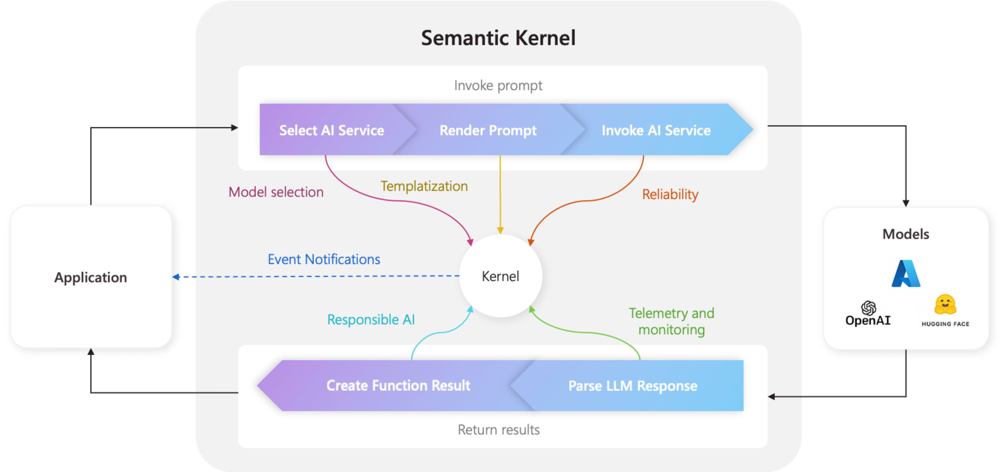
What is Semantic Kernel?
Notes:
This diagram shows the end-to-end flow inside Semantic Kernel when your app invokes an AI prompt. On the left is your application—it calls into the Kernel, handing off the user’s request.
First, the Kernel’s top-half pipeline takes over:
Select AI Service: based on your configuration or runtime hints the Kernel chooses which model to call—Azure OpenAI, OpenAI’s API, Hugging Face, or any other service you’ve plugged in.
Render Prompt: it applies templating to merge your prompt template with real inputs, ensuring consistency and repeatability.
Invoke AI Service: it handles the actual API call, including retries and fallbacks so you get reliable results even under transient failures.
The response from the model then enters the bottom pipeline: 4. Parse LLM Response: the Kernel interprets raw text or structured output, extracting the data you need. 5. Create Function Result: it wraps that data in a FunctionResult object, ready for your code to consume.
At the center is the Kernel itself—providing telemetry for monitoring, event notifications for extensibility, and built-in hooks for responsible AI checks. That shared core ensures every invocation benefits from consistent model selection policies, prompt templating, reliability safeguards, and observability—but you still have full control to customize or extend any step.
In practice, this means you write just a few lines to register your prompt templates and functions, and Semantic Kernel takes care of the rest—so you can focus on business logic rather than plumbing.

Slide 10
Core Concepts
Kernel
Skills (Functions)
The central object in Semantic Kernel, managing connections and function execution
Reusable units of AI or native logic
Semantic Functions: Natural language prompts
Native Functions: Traditional Code
Connectors
Planners (Not Mentioned)
Bridges to various AI Services (Azure OpenAI, Hugging Face, etc)
Intelligent components that create sequences of functions to achieve complex goals
Notes:
To understand how Semantic Kernel works its magic, let's look at some of its core concepts, framed in a way that should resonate with your .NET development experience.
At the heart of Semantic Kernel is the Kernel itself. Think of this as the central orchestrator, much like your IServiceProvider in dependency injection. It manages the connections to your AI services – in our case, your Azure GPT-4o endpoint – and handles the execution of different AI and native functions.
Speaking of functions, Semantic Kernel organizes logic into Skills, which are essentially collections of Functions. We have two main types:
First, Semantic Functions. These are where the AI magic truly happens. You define them using natural language prompts. Imagine telling GPT-4o, 'Here's a citizen's question, tell me what they're trying to do.' Semantic Kernel takes that prompt and handles the communication with the LLM for you. It's like having a method where the 'implementation' is a powerful AI model.
Second, Native Functions. These are your familiar C# methods – the code you write every day. You can register these with the Kernel, allowing you to seamlessly integrate your existing .NET logic with AI-powered functions. Think of accessing databases, performing validations, or any other custom logic you've already built.
Finally, Connectors are the bridges that allow Semantic Kernel to talk to different AI services. For our demo today, we'll be focusing on the Azure OpenAI Connector to interact with your GPT-4o deployment.

Slide 11
Code Snippet (Semantic Function)
// Conceptual: Initializing the Kernel with your GPT-4o endpoint
using Microsoft.SemanticKernel;
using Microsoft.SemanticKernel.Connectors.OpenAI;
IKernel kernel = new KernelBuilder()
.WithAzureOpenAIChatCompletion(
deploymentName: "your-gpt4o-deployment-name",
endpoint: "your-gpt4o-endpoint",
apiKey: "your-gpt4o-key")
.Build();
// Conceptual: Loading a Semantic Function
var citizenIntentSkill = kernel.CreateSemanticFunction("Determine the intent of the following citizen inquiry: {{$inquiry}}");
// Conceptual: Calling the function
var result = await citizenIntentSkill.InvokeAsync(kernel, new KernelArguments { ["inquiry"] = "I need to renew my driver's license." });
string intent = result.GetValue<string>();
Notes:
As you can see in this conceptual code snippet, initializing the Kernel and loading a Semantic Function is quite straightforward. We provide our Azure OpenAI credentials and then define a function simply by giving it a prompt. This function can then be called like any other method in our .NET code.

Slide 12
Code Snippet (Native Function)
// Define a Native Function (C# class)
public class InquiryClassifier
{
[SKFunction, Description("Classifies an inquiry.")]
public string Classify([Description("The inquiry text.")] string inquiry)
{
if (inquiry.Contains("license")) return "Motor Vehicle Services";
if (inquiry.Contains("tax")) return "Taxation";
return "General Inquiry";
}
}
// Load the Native Function
kernel.ImportPluginFromObject(new InquiryClassifier(), "InquiryClassifierPlugin");
// Call the Native Function
var nativeResult = await kernel.InvokeAsync("InquiryClassifierPlugin”, "Classify",
new KernelArguments { ["inquiry"] = "I need to renew my driver's license." });
string category = nativeResult.GetValue<string>();
Notes:
As you can see in this conceptual code snippet, initializing the Kernel and loading a Semantic Function is quite straightforward. We provide our Azure OpenAI credentials and then define a function simply by giving it a prompt. This function can then be called like any other method in our .NET code.

Slide 13
Additional Info
Secrets Retrieval
Import APIs from OpenApi Spec APIs
Logic Apps Integration
MCP Integration (Coming Soon)
Notes:
Use SK to turn a console app with a few plugins into an MCP server

Slide 14
Demos Adding tools to your AI Agents using Semantic Kernel 1. Function Tools 2. Semantic Tools
Notes:
Use SK to turn a console app with a few plugins into an MCP server

Slide 15
Benefit for Public Sector Developers
Enhanced Services
Efficiency
Analytics
Build intelligent chatbots, automate responses to common inquiries, and provide personalized assistance
Automate document processing (summarizing reports, extracting key information), streamline workflows, reduce manual tasks
Leverage LLMs for sentiment analysis of public feedback, identifying trends in data, and generating insightful reports
Accessibility
Integration
Security & Compliance
Create more accessible interfaces through natural (multi) language understanding.
Seamlessly connect AI capabilities with your existing .NET applications and databases
Easily integrate data privacy, security, and compliance requirements
Notes:
So, why should developers like us be excited about Semantic Kernel? The benefits are numerous and directly address many of the challenges and opportunities within the public sector.
Firstly, it can significantly enhance citizen services. Imagine building intelligent chatbots that can understand complex inquiries, provide accurate information, and guide citizens through processes, all in natural language. This improves accessibility and reduces the burden on human agents.
Secondly, it can lead to improved efficiency. Think about automating the analysis of large volumes of documents, extracting key information from reports, or streamlining complex workflows that currently involve manual steps. Semantic Kernel can be a powerful tool for automation.
It also opens doors for data analysis and insights. You can leverage LLMs to perform sentiment analysis on citizen feedback, identify emerging trends in data, and generate insightful reports that can inform policy decisions.
Furthermore, by enabling natural language understanding, Semantic Kernel can contribute to accessibility and inclusivity in your applications.
Crucially, it's designed for integration with existing systems. You can seamlessly connect these new AI capabilities with your current .NET applications and government databases, leveraging your existing infrastructure.
Finally, and this is a critical point for government, while Semantic Kernel facilitates AI integration, it's paramount to emphasize security and compliance. When working with LLMs and sensitive government data, you must carefully consider data privacy, security protocols, and all relevant government regulations. Semantic Kernel provides the tools, but responsible implementation and adherence to best practices are essential.
By embracing Semantic Kernel, you can build more intelligent, efficient, and citizen-centric government applications right within your familiar .NET environment."
Now, we're ready to move on to the live demonstration where you'll see these concepts in action with a scenario relevant to the work you do every day.

Slide 16
Part 3
Model Context Protocol Unlock Deeper Interactions By Managing Context

Slide 17
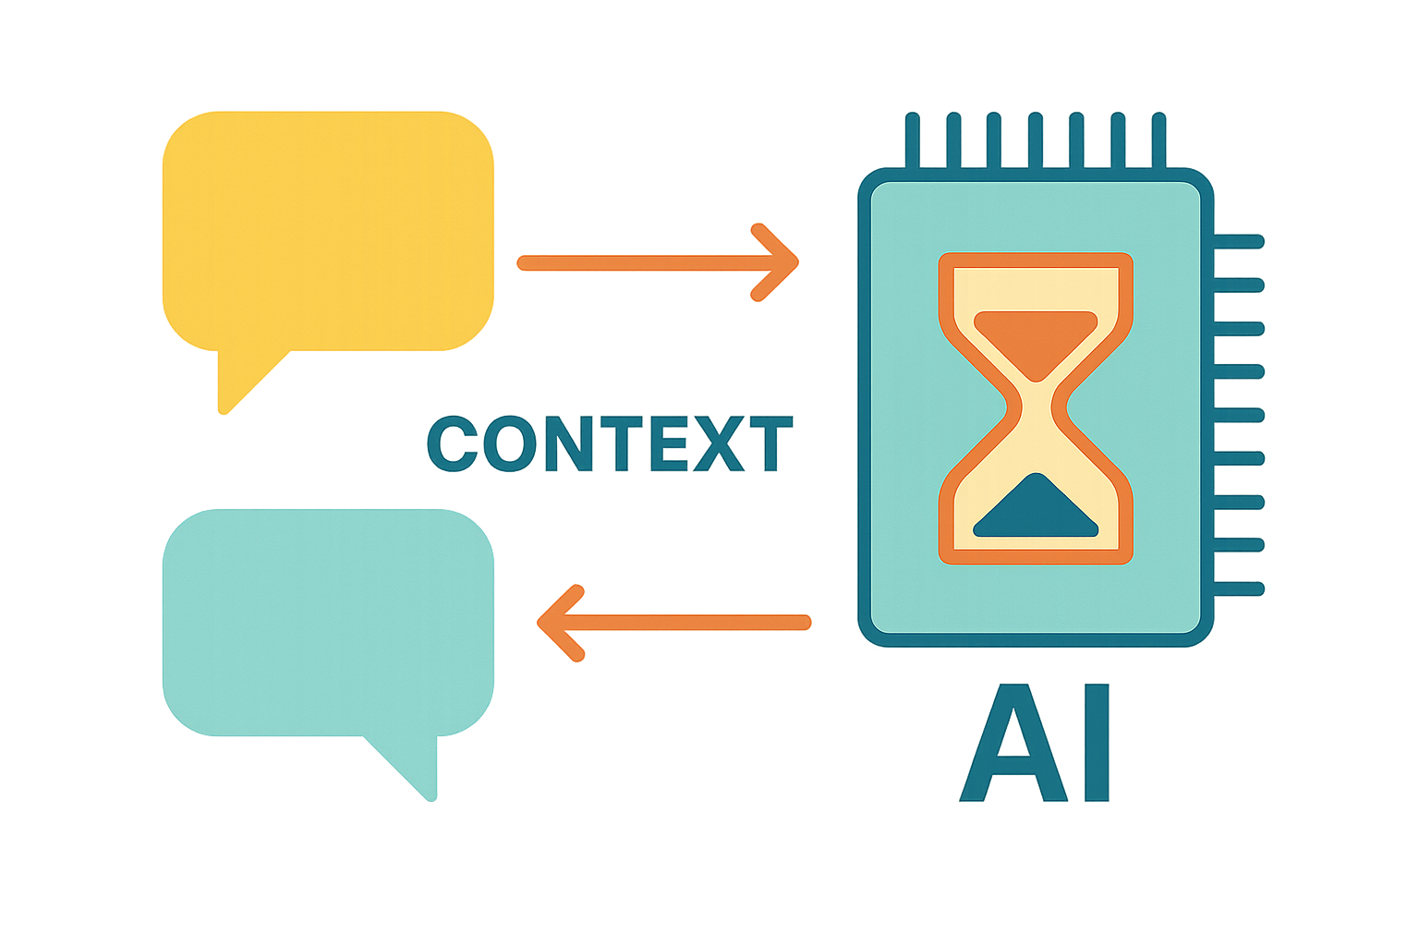
What is Context?
All the information provided to a Language Model in a single interaction (user input, past turns, external data, instructions)
Why is it Crucial?
Enables coherent, relevant, and personalized responses in multi-turn conversations.
Context Window Limit
LLMs have a finite amount of text they can process at once. Exceeding this limit can lead to errors or truncated information
The Challenge
Effectively managing context to stay within limits while maintaining relevant information is key for robust applications.
Notes:
Now, let's delve into a critical aspect of building truly intelligent and engaging AI applications: context. In any conversation, remembering what was said before is key to understanding and responding appropriately. The same holds true for our interactions with Language Models.
Context encompasses all the information we provide to the AI in a single turn – this includes the user's current input, but also any relevant past turns in the conversation, external data we might feed in, and specific instructions.
Why is this crucial? Because without context, the AI operates in a vacuum. It can't provide coherent follow-ups, remember user preferences, or understand the nuances of an ongoing discussion. Effective context management is what allows for truly meaningful and personalized interactions.
However, there's a significant challenge: Language Models have a finite context window – a limit on the amount of text they can process at any given time. Exceeding this limit can lead to errors, truncated information, or simply poorer quality responses as the AI 'forgets' earlier parts of the conversation.
Therefore, the art of building robust AI applications lies in effectively managing this context – ensuring we provide enough relevant information without overwhelming the model or exceeding its limitations. This is where the principles of Model Context Protocol come into play

Slide 18

Clarity & Structure
Organize context logically (e.g., separate user turns, bot responses, metadata).
Relevance & Conciseness
Include only necessary information for the current turn. Reduce context size (e.g., summarization, truncation).
What is MCP?
Temporal Awareness
Strategically manage conversation history
Benefits of MCP
Improved response quality, reduced token usage (cost savings), better handling of long conversations, increased reliability
Notes:
So, how do we tackle this challenge of context management? This leads us to the Model Context Protocol, or MCP. Now, MCP isn't a rigid, universally adopted standard yet, but rather a set of guiding principles and best practices for structuring and optimizing the conversational input we provide to Language Models. Think of it as a set of guidelines for being a good conversational partner with AI.
Here are some key principles of MCP:
Clarity and Structure: Organize your context logically. Separate user turns from bot responses, clearly delineate any external data, and provide metadata where necessary.
Relevance: Be selective. Include only the information that is truly pertinent to the current turn. Don't just dump the entire conversation history if only the last few turns are relevant.
Conciseness: Be mindful of the context window. Employ techniques like summarization to condense long passages or truncate less important information when necessary.
Temporal Awareness: Strategically manage the conversation history. Decide how many past turns to include and how to represent them.
Source Attribution (if applicable): If you're injecting information from external sources, it can be helpful to indicate where that information came from.
By adhering to these principles, we can achieve several benefits: We'll see improved response quality as the AI has the right information at its fingertips, we can reduce our token usage and potentially save on costs, our applications will be better at handling long and complex conversations, and ultimately, we'll build more reliable and user-friendly experiences.

Slide 19
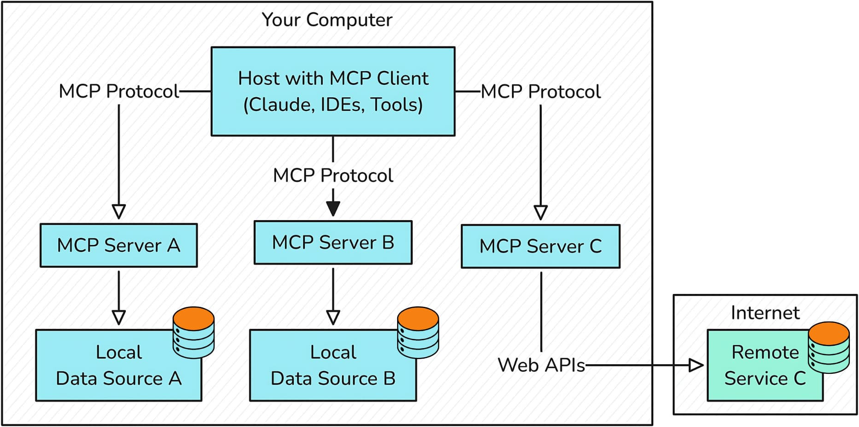
Model Context Protocol
Drive growth
Notes:
Your MCP Host is the application you interact with—say your IDE or a desktop AI tool. Embedded within that host is an MCP Client, a lightweight library that opens and maintains a dedicated channel to each MCP Server you register.
Each MCP Server is a small process exposing a specific capability—like a summarization function, data lookup, or business-logic API—over the same JSON envelope. Servers can securely access Local Data Sources (files, databases, private APIs) without giving the host direct file-system or database credentials, and they can also reach Remote Services on the internet.
From a developer’s perspective, MCP means you write one uniform protocol client in your host, then spin up or hook into any number of servers—local or remote—and orchestrate them all through the same JSON-over-HTTP/WS interface. This makes building complex, multi-step agent workflows that blend local and external data seamless and consistent.

Slide 20
Demos 1. Agent-to-Agent Communication with Semantic Kernel + MCP 2. Adding MCP tools to VSC
Notes:
Use SK to turn a console app with a few plugins into an MCP server

Slide 21
Part 4
Azure AI Foundry Agent Service PaaS Host for Your Agents

Slide 22

Production Readiness
AAS provides the managed environment for your agents to operate at scale
Azure AI Foundry - AI Agent Service
Unified AI Platform
Part of Azure AI Foundry, which brings together models, tools, frameworks, and governance into one system
Focus on Logic, Not Infrastructure
Focus on agent logic and tools, offloading the complexities of hosting, scaling, & managing the AI runtime
Security & Compliance
Built-in features like governance, observability, and security
Notes:
Now let’s move on to the next logic step in the AI Agents journey. We’ve learned about the basics of communicating with your LLMs in Azure, but here’s where Azure really shines over anyone else in the game: A PaaS for your Agents. Think App Services / Web App Services for your Agents.
Azure AI Foundry Agent Service, AAS (because we all love more acronyms) is essentially a dedicated factory for your agents, providing robust infrastructure and capabilities to run reliably in production… at scale. - Firstly, it's all about Production Readiness. While Semantic Kernel is absolutely fantastic for rapid prototyping, developing your agent's core logic, and orchestrating interactions locally, Azure Agent Service provides that crucial managed environment. It's where your agents go when they need to operate at scale, handle real-world traffic, and run continuously without you manually babysitting them - Secondly, it's about being part of a Unified AI Platform. AAS is a core component of Azure AI Foundry. This means it seamlessly integrates with other Azure AI services – like Azure OpenAI for your models, Azure AI Search for your RAG patterns, and Azure Functions for your custom tool logic. It’s a cohesive ecosystem designed for enterprise AI. - And critically for us developers, it allows you to Focus on Logic, Not Infrastructure. We love writing C# code, solving business problems, and crafting elegant agent behaviors. We don't want to spend our time configuring Kubernetes clusters, managing scaling policies, or setting up complex monitoring. Azure Agent Service handles those operational complexities for you, allowing you to focus your C# expertise on the agent's intelligence and tool integrations.

Slide 23
Core Components
Models & Customization
AI Tools
Orchestration
Safety & Observability
Integrate with various LLMs (OpenAI, Llama, Mistral, Cohere, etc). Fine tune and prompt engineering for specific behaviors
Connect agents to enterprise knowledge (Azure AI Search, SharePoint, Bing, Azure Functions, Logic Apps, more)
Manage tool calls, thread state, retries, and logging automatically
Full thread-level visibility, logging, tracing, Application Insights integration
Notes:
So, how does Azure Agent Service achieve this promise of a production-ready agent environment? Let's break down its core components, which are designed to support the entire lifecycle of your intelligent agents.
At the heart of any agent are the Models. Azure Agent Service provides seamless integration with a wide variety of Large Language Models. This includes Azure OpenAI models like GPT-4, but also increasingly, popular open-source models available through Azure like Llama, Mistral, and Cohere. You define which model your agent uses, and AAS handles the underlying deployment and scaling
Next, and extremely vital for any useful agent, are AI Tools. These are the agent’s 'hands' and 'eyes' into the real world. AAS allows you to connect your agents to enterprise knowledge bases – think Azure AI Search for RAG, SharePoint for internal documents, or even Bing for external web searches, as you saw in the demo. Crucially for us C# developers, it also lets you connect to actions through Azure Functions, Logic Apps, or any OpenAPI-defined API. This is where your custom C# code can be exposed to your agent as a callable tool.
The brain, the conductor of the orchestra, is Orchestration. This is where Azure Agent Service truly differentiates itself. It automatically manages the complex dance of tool calls, maintains the conversation thread state, handles retries for transient failures, and provides detailed logging of the agent's decision-making process. This built-in orchestration layer is what saves you immense development effort in managing agent workflows.
Finally, for any enterprise deployment, especially in a public sector context, Trust, Safety & Observability are absolutely paramount. Your agents need to be secure, compliant, and transparent. Azure Agent Service is built on Azure's robust security principles, including built-in content filters for responsible AI usage, deep integration with Microsoft Entra ID for identity and access control, Role-Based Access Control (RBAC) for granular permissions, and encryption of data at rest and in transit. Beyond just security, it provides crucial observability: full thread-level visibility into agent interactions, comprehensive logging of its decisions and tool invocations, and seamless integration with Azure Application Insights for detailed telemetry. This combined focus ensures your agents are not only effective but also trustworthy, auditable, and continuously improvable in a production environment.

Slide 24
Demo CA Service Chatbot
Notes:
Use SK to turn a console app with a few plugins into an MCP server

Slide 25
Part 5
Resources & Next Steps

Slide 26
Appendix
Backup Slides
Notes:
Let’s start with Copilot.
Copilot isn’t just a product or set of products – it’s a metaphor.
It stands for AI empowering human achievement, making us each reach our potential more effectively.

Slide 27
SDK (Not a Service)
Example 4-Step Wire-up
Nothing to deploy, just drop into any .NET project
//1. Create a kernel builder and attach your LLM
var builder = Kernel.CreateBuilder()
.AddAzureOpenAIChatCompletion("gpt-4o", endpoint, key);
//2. Build the kernel object
var kernel = builder.Build();
//3. Register your plugin (each method becomes an MCP tool)
kernel.Plugins.AddFromType<HolidayPlugin>();
// Ask the user for a date at run time
Console.Write("Enter a date (yyyy-MM-dd): ");
var dateInput = Console.ReadLine();
//4. Invoke the tool with that user-supplied argument
var reply = await kernel.InvokeAsync(
"IsPublicHoliday",
new() { ["date"] = dateInput });
Console.WriteLine(reply);
Plugins = tools
Each plugin method automatically becomes a tool the LLM can call
Pluggable Memory
Memory back-ends are swappable
Server Switch
Flip a switch and turn it into an MCP server
Notes:
First, SK is just an SDK—no server to deploy. Drop it into any .NET project.
You only need four calls to stand up an agent: create a builder, build the kernel, register plugins, invoke.
Each plugin method automatically becomes a tool the LLM can call.
Memory back-ends are swappable, but we’ll keep that for later.
Flip a switch and the process turns into an MCP server; hold that thought for another slide Step 1: wire in an LLM—here I’m using Azure OpenAI, but you can drop in OpenAI.com or a local model the same way.
Step 2: build the kernel object.
Step 3: one line registers our HolidayPlugin; SK reflects on it and generates a JSON schema automatically.
Step 4: we grab a date from the console and call the tool. The agent hits the public-holiday API, and we print the answer.
That’s all it takes to turn ordinary C# methods into LLM-callable tools. Now the obvious question is: how does an external host discover and invoke those tools?—enter the Model Context Protocol, which we’ll cover next.

Slide 28
Language-Agnostic Standard
Client->Server Payload
Defines a JSON envelope for passing context between LLMs, tools and agents
{
"jsonrpc": "2.0",
"method": "call_tool",
"params": {
"sessionId": "abc123",
"toolName": "search_docs",
"input": { "query": "MCP specification" },
"memory": {
"user": "developer@example.com",
"history": ["Asked about tool definitions"]
}
},
"id": 1
}
Dynamic Tool Invocation
Embeds tool metadata so agents discover and call APIs/functions at runtime
Multi-Transport Support
Works over stdio, SSE, WebSocket or HTTP to fit your architecture
Notes:
Model Context Protocol, or MCP, is the open, JSON-based contract that underpins agentic AI. I always find it helpful to understand how technical concepts get their name, in this case, Model Context Protocol is literally the protocol for how model context is transmitted (think of how HTTP is the protocol for transmitting hypertext)
First, it’s a language-agnostic standard, so any SDK or service can emit and consume the same context envelope.
Next, it supports dynamic tool invocation, embedding tool metadata so agents can discover and call APIs or functions at runtime.
Finally, multi-transport support means MCP works over stdio, SSE, WebSocket or HTTP—so you can integrate it into almost any system.
On the right is a simplified MCP payload
- At the top, you’ll see jsonrpc: 2.0—MCP uses the JSON-RPC 2.0 standard for all communication.
- The method is call_tool, which tells the MCP server the model wants to invoke a specific tool.
- Inside params, we pass a sessionId to group related requests, the toolName we want to call—in this case, search_docs—and the input to that tool, which is just a simple query string.
- We also pass a memory block that contains stored context—like the user ID and recent conversation history. This lets the tool use past interactions or user identity when responding.
- Finally, the id helps track responses, just like in a typical API call.
So, this whole payload is essentially the model saying: “I need to run the search_docs tool using this user’s memory and this specific query.”
The MCP server executes the tool and sends back a response the agent can reason over

Slide 29
Tool Discovery (Client Request)
Tool Discovery (Server Response)
{
"jsonrpc": "2.0",
"method": "get_manifest",
"id": 1
}
{
"jsonrpc": "2.0",
"id": 1,
"result": {
"tools": [
{
"name": "get_user_profile",
"description": "Retrieves a user's profile by email",
"parameters": {
"type": "object",
"properties": {
"email": { "type": "string", "format": "email" }
},
"required": ["email"]
}
},
{
"name": "list_recent_queries",
"description": "Returns the last 5 queries made by the user",
"parameters": {
"type": "object",
"properties": {}
}
. . .
}
Notes:
"Now let’s look at how the agent discovers what tools an MCP server offers."
The agent starts by sending a get_manifest request. This is a simple JSON-RPC message that asks, "What tools do you support?"
The MCP server responds with a list of tools. Each tool includes a name, a description, and a JSON schema describing its parameters—if it has any.
In this example, the server provides two tools:
get_user_profile, which takes an email address as input
And list_recent_queries, which takes no parameters and can be called with an empty object
This manifest allows the model to understand what capabilities are available and how to use them. It can then decide when to call each tool based on the user’s prompt.

Slide 30
Demo – Building Your First Agent TODO

Slide 31
Error Handling, Retries, Responsible-AI Hooks, Telemetry, Versioning, etc

Slide 32
GitHub Samples, Docs, Quickstarts, etc

Slide 33
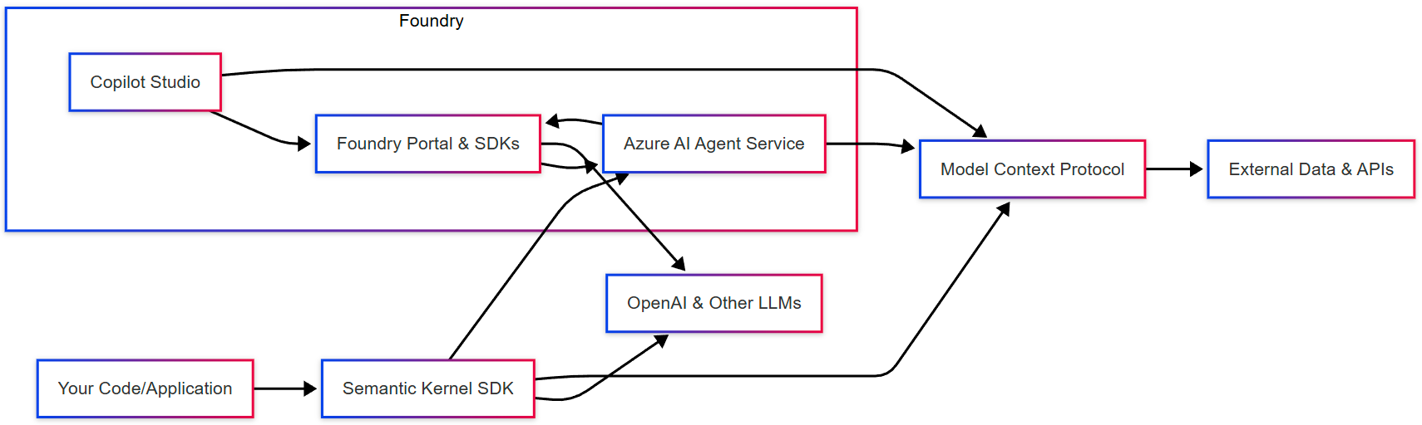
Microsoft AI Ecosystem
Notes:
Here you see the five pillars of an AI agent, each represented by an icon.
First is the Natural-Language Interface, that’s how users and systems talk to the agent using plain English.
Next is the LLM, our brain box that reasons, plans and decides what to do based on those instructions.
Then comes the Integrated Toolset, the external APIs or services the agent can call to take action—everything from web search to custom functions.
After that we have Memory, which lets the agent remember past steps and maintain context across a conversation or workflow.
And finally Security and Governance, ensuring every API call and data transaction is compliant, auditable and enterprise-grade.
Together these elements form the end-to-end pipeline of an AI agen

Slide 34
Agent Definition
Properties
Example
Declarative Setup
var builder = AgentBuilder.Create("myAgent")
.UseModel(model => model
.Service(“azureOpenAI”)
.Model("gpt-4o"))
.WithPromptTemplate("Summarize this report: {input}")
.AddTool("bingSearch", new BingSearchTool(apiKey))
.Build();
var result = await builder.RunAsync(new { input = reportText });
Console.WriteLine(result.Output);
Model Agnostic
Behavior First
Zero Infrastructure
Notes:
On this slide we zoom in on Agent Definition. First, notice how we declare our agent in code—model, prompt template and tools—without touching any infra or security settings. It’s entirely declarative and model-agnostic, so you can swap in different backends by changing a name.
Next, the snippet on the right shows how to:
Instantiate an agent named ‘myAgent’
Point it at an Azure OpenAI model (here, GPT-4o)
Attach a Bing Search tool
Run the agent with an input and immediately get back its natural-language response.
You focus purely on what the agent does—everything else is zero-ops.”

Slide 35
Tool Registration
Tools
Example
var builder = AgentBuilder.Create("myAgent")
// built-in connector
.AddTool("bingSearch", new BingSearchTool(bingKey))
// file retrieval tool
.AddTool("fileStore", new FileStoreTool(blobConnection))
// Azure Function tool
.AddTool("notify", new HttpTool("https://myfunc.azurewebsites.net/api/notify"))
// custom queue-based tool
.AddTool("orderQueue", new QueueTool(serviceBusConnection, "orders"))
.Build();
Built-in Connectors – out-of-the-box tools for Bing Search, Azure AI Search, File Store, and Azure Functions
Custom Tools – plug in any HTTP endpoint or message-queue handler as a tool in your agent
Tool Settings – configure timeouts, retry policies, parallelism, and caching per tool
Extensible Ecosystem – combine Microsoft-provided tools with your own business-logic functions
Notes:
Tool Registration is where your agent gains capabilities. On the left you see two main categories—built-in connectors like Bing Search, Azure AI Search, file retrieval and Functions, plus the ability to register any HTTP or queue endpoint you need.
You can also customize each tool’s behavior—set timeouts, retry policies, parallelism or caching—to match your SLAs. And because agents use the same pattern for built-in and custom tools, you get a consistent, extensible ecosystem.
On the right is an example: we add the Bing Search and File Store tools directly, then wire up an Azure Function via its HTTP URL, and even hook into a Service Bus queue named ‘orders.’ Once registered, the agent can call these tools by name in your prompts or workflows—no SDK wiring required.

Slide 36
Stateful Execution & Threading
Automatic Context Persistence
Parallel Tool Invocation
Built-In Retries and Isolation
Persists every message and tool output in threads behind the scenes (no state stores)
Branching and resuming complex flows – support pause & restart
Configurable storage backends
Launch independent tool calls concurrently (search, HTTP, Functions)
Aggregate and sequence results – preserve logical ordering
Fan-out/fan-in patterns
Retry policies applied per tool (backoff, transient failures, etc)
Fault isolation keeps scoped to single step
Detailed diagnostics and metrics for each invocation for troubleshooting
Notes:
First, Automatic Context Persistence: • Every user message and tool output is automatically saved—no hand-rolled state stores. • You can branch, pause, and later resume multi-step flows without losing track. • Pick your backend—Cosmos DB for speed or Blob storage to optimize cost.
Next, Parallel Tool Invocation: • Agents fan out multiple API calls—search, HTTP endpoints, Functions—at the same time to cut end-to-end latency. • The service then sequences and merges those results for you, preserving logical order. • You get built-in fan-out/fan-in patterns, ideal for batch data enrichment or real-time aggregation.
Finally, Built-In Retries & Isolation: • Configure retry policies per tool—exponential backoff, max attempts—so transient errors self-heal. • Failures are contained to the affected branch; the rest of your workflow keeps running. • Detailed invocation diagnostics help you pinpoint and fix issues fast.
Together, these capabilities let you focus on business logic—declaring high-level workflows—while Azure AI Agent Service handles context, concurrency, and resilience under the hood.

Slide 37
Audit & Governance
Activity logs & diagnostics in Azure Monitor for every agent run and tool call
Role-Based Access Control scoped to agent resources and tools
Built-in retention policies and export to Azure Storage or SIEM
Network Isolation
Security & Compliance
VNet integration & Private Endpoints keep all traffic off the public internet
Service tags & NSGs to whitelist only approved subnets and IP ranges
Platform-managed DDoS protection and regional fault isolation
Capabilities
Secure by Default
Encryption & Keys
At-rest & in-transit encryption with your own Azure Key Vault keys
Bring-Your-Own-Key (BYOK) support for FIPS-compliant HSMs
Automatic envelope encryption of conversation state and tool payloads
Notes:
Security and compliance are baked into Azure AI Agent Service at every layer.
First, Customer-Managed Keys and Encryption let you enforce your organization’s key-rotation policies. Your conversation data and tool payloads are envelope-encrypted with keys in your Key Vault, and you can even bring FIPS-certified HSMs.
Next, Network Security and Isolation ensure no traffic ever touches the public internet. Agents run in your VNet, you can lock down Private Endpoints with NSGs and service tags, and Azure’s platform DDoS protection guards against volumetric attacks.
Finally, Auditing and Governance give you full visibility and control: every API call and agent execution is logged to Azure Monitor, you control who can manage or invoke agents via RBAC, and you can configure retention or forward logs to your SIEM for long-term compliance.

